Slide 1

IMPLEMENTAREA CONCURENTEI IN LIMBAJE DE PROGRAMARE
Ioana Leustean
INTRODUCERE IN
ERLANG
http://www.erlang.org/

Slide 2
Bibliografie
Joe Armstrong, Programming Erlang, Second Edition 2013
Fred Hébert, Learn You Some Erlang For Great Good, 2013
Varianta online

Slide 3
Tratarea erorilor
Error handling in concurrent Erlang programs is based on the idea of remote
detection and handling of errors. Instead of handling an error in the process
where the error occurs, we let the process die and correct the error in some
other process."
Joe Armstrong, Programming Erlang, Second Edition 2013
OTP
OTP stands for Open Telecom Platform, although it's not that much about telecom anymore (it's more about software that has the property of telecom applications, but yeah.) If half of Erlang's greatness comes from its concurrency and distribution and the other half comes from its error handling capabilities, then the OTP framework is the third half of it.
http://learnyousomeerlang.com/what-is-otp#its-the-open-telecom-platform

Slide 4
-module(myserver).
-export([start/2, client/2]).
start(Name, Mod) -> register(Name, spawn(fun() -> loop(Name, Mod) end)).
client(Name, Request) ->
Name ! {self(), Request},
receive
{Name, Response} -> Response
end.
loop(Name, Mod) ->
receive
{From, Request} -> Response = Mod:handle(Request),
From ! {Name, Response},
loop(Name, Mod)
end.
comportamentul de baza al clientului
comportamentul de baza al serverului,
parametrizat cu un modul Mod

Slide 5
Modulul "callback" nu contine
nimic legat de concurenta!
-module(callback_mod).
-export([client1/1, client2/1, handle/1]).
-import(myserver, [client/2]).
%% client
client1(N) -> client(myserver, {add, N}).
client2(Name) -> client(myserver, {hello, Name}).
%% callback
handle({add, N}) -> {ok, N+1};
handle({hello, Name}) -> {ok,"hello "++ Name}.
interfata clientului
functiile callback care sunt apelate din modulul serverului

Slide 6
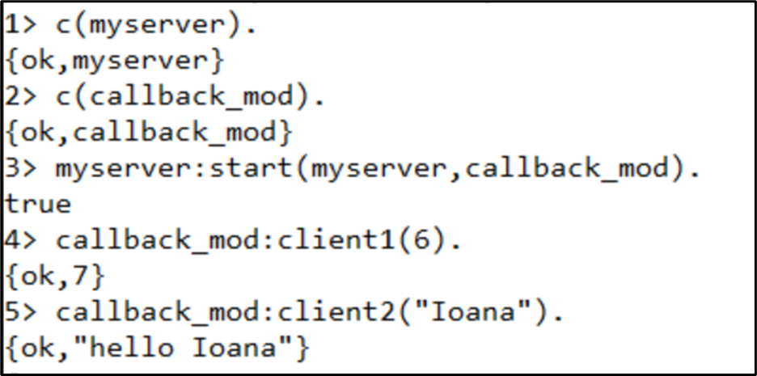
-module(callback_mod).
-export([client1/1, client2/1, handle/1]).
-import(myserver, [client/2]).
%% client
client1(N) -> client(myserver, {add, N}).
client2(Name) -> client(myserver, {hello, Name}).
%% callback
handle({add, N}) -> {ok, N+1};
handle({hello, Name}) -> {ok,"hello "++ Name}.
Modulul "callback" nu contine
nimic legat de concurenta!
interfata clientului
functiile callback care sunt apelate din modulul serverului

Slide 7
Separam codul pur functional de partea comportamentala (behaviour)
Modulul server descrie comportamentul de baza,
continue codul concurent si
este parametrizat de modulul callback
Modulul "callback" nu contine
nimic legat de concurenta!
-module(myserver).
-export([start/2, client/2]).
start(Name, Mod) -> register(Name, spawn(fun() -> loop(Name, Mod) end)).
client(Name, Request) ->
Name ! {self(), Request},
receive
{Name, Response} -> Response
end.
loop(Name, Mod) ->
receive
{From, Request} -> Response = Mod:handle(Request),
From ! {Name, Response},
loop(Name, Mod)
end.
-module(callback_mod).
-export([client1/1, client2/1, handle/1]).
-import(myserver, [client/2]).
%% client
client1(N) -> client(myserver, {add, N}).
client2(Name) -> client(myserver, {hello, Name}).
%% callback
handle({add, N}) -> {ok, N+1};
handle({hello, Name}) -> {ok,"hello "++ Name}.

Slide 8
Server cu tratarea erorilor
-module(myservertc).
-export([start/2, client/2]).
start(Name, Mod) ->
register(Name, spawn(fun() -> loop(Name, Mod) end)).
client(Name, Request) ->
Name ! {self(), Request},
receive
{Name, Response} -> Response;
{Name, myError} -> exit(myError)
end.
loop(Name, Mod) ->
receive
{From, Request} ->
try Mod:handle(Request) of
Response -> From ! {Name, Response},
loop(Name, Mod)
catch
_:Reason -> io:format("Server ~p exception ~p~n",
[Name, Reason]),
From ! {Name, myError},
loop(Name, Mod)
end

Slide 9
-module(callback_mod_er).
-export([client1/1, client2/1, client3/2, handle/1]).
-import(myservertc, [client/2]).
%% client
client1(N) -> client(myserver, {add, N}).
client2(Name) -> client(myserver, {hello, Name}).
client3(N,M) -> client(myserver,{division,N,M}).
%% callback
handle({add, N}) -> {ok, N+1};
handle({hello, Name}) -> {ok,"hello "++ Name};
handle({division, N,M}) -> {ok,N / M}.

Slide 10
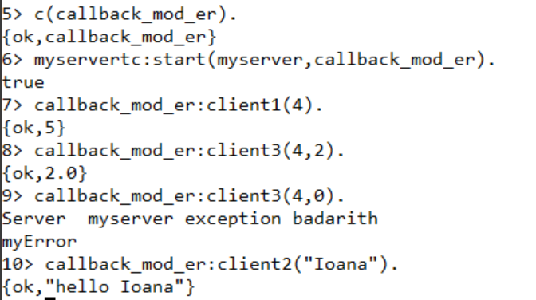
-module(callback_mod_er).
-export([client1/1, client2/1, client3/2, handle/1]).
-import(myservertc, [client/2]).
%% client
client1(N) -> client(myserver, {add, N}).
client2(Name) -> client(myserver, {hello, Name}).
client3(N,M) -> client(myserver,{division,N,M}).
%% callback
handle({add, N}) -> {ok, N+1};
handle({hello, Name}) -> {ok,"hello "++ Name};
handle({division, N,M}) -> {ok,N / M}.

Slide 11
Server cu schimbarea comportamentului
-module(myserver2).
-export([start/2, client/2,change_behaviour/2]).
start(Name, Mod) ->
register(Name, spawn(fun() -> loop(Name, Mod) end)).
client(Name, Request) ->
Name ! {self(), Request},
receive
{Name, Response} -> Response
end.
change_behaviour(Name, Mod) -> client(Name, {change, Mod}).
loop(Name, Mod) ->
receive
{From, {change, NewCallBack}} -> From ! {Name, i_will_change},
loop(Name, NewCallBack);
{From, Request} -> Response = Mod:handle(Request),
From ! {Name, Response},
loop(Name, Mod)
end.

Slide 12
Server cu schimbarea comportamentului: mai multe module callback
-module(callback_mod2).
-export([client1/1, client2/1, handle/1]).
-import(myserver2, [client/2]).
%% client
client1(N) -> client(myserver, {add, N}).
client2(Name) -> client(myserver, {hello, Name}).
%% callback
handle({add, N}) -> {ok, N+1};
handle({hello, Name}) -> {ok,"hello "++ Name}.
-module(callback_new).
-export([client1/1, client2/1, handle/1]).
-import(myserver2, [client/2]).
%% client
client1(N) -> client(myserver, {multiply, N}).
client2(Name) -> client(myserver, {hate, Name}).
%% callback
handle({multiply, N}) -> {ok, N*N};
handle({hate, Name}) -> {ok,"I hate you, "++ Name}.

Slide 13
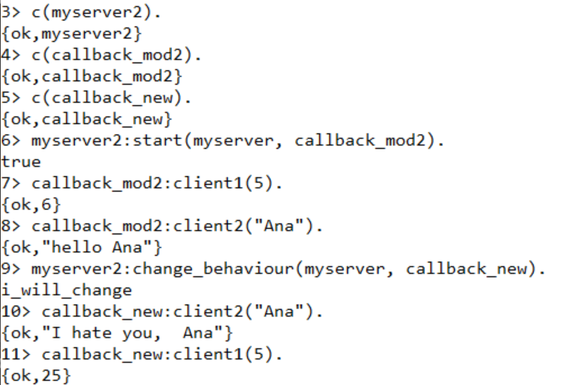
Schimbarea comportamentului serverului in mod dinamic

Slide 14
"This is what OTP really is all about: taking all the generic components, extracting them in libraries, making sure they work well and then reusing that code when possible.
Adding servers adds complexity in terms of code, but also in terms of testing, maintenance and understanding. Each implementation might be different, programmed in different styles by different people, and so on. However, if all these servers share the same common my_server abstraction, you substantially reduce that complexity. You understand the basic concept of the module instantly ("oh, it's a server!"), there's a single generic implementation of it to test, document, etc. The rest of the effort can be put on each specific implementation of it.
Another interesting thing about what we did when separating the generic from the specific is that we instantly made it much easier to test our individual modules.
A much more 'hidden' advantage of using common abstractions in that way is that if everyone uses the exact same backend for their processes, when someone optimizes that single backend to make it a little bit faster, every process using it out there will run a little bit faster too. For this principle to work in practice, it's usually necessary to have a whole lot of people using the same abstractions and putting effort on them. Luckily for the Erlang community, that's what happens with the OTP framework."
https://learnyousomeerlang.com/what-is-otp#its-the-open-telecom-platform

